Slide 1
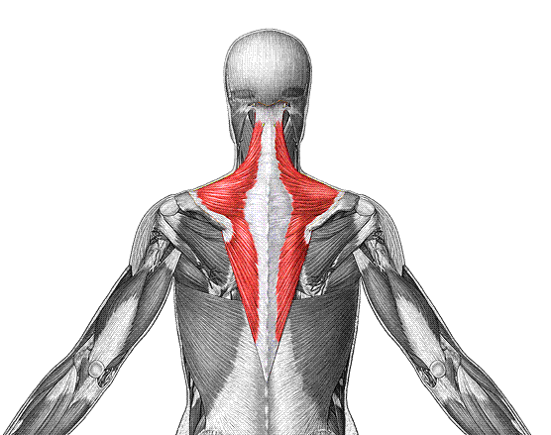
O: occipital bone, vertebrae
I: scapula
F: extend head, fix scapula
Trapezius

Slide 2
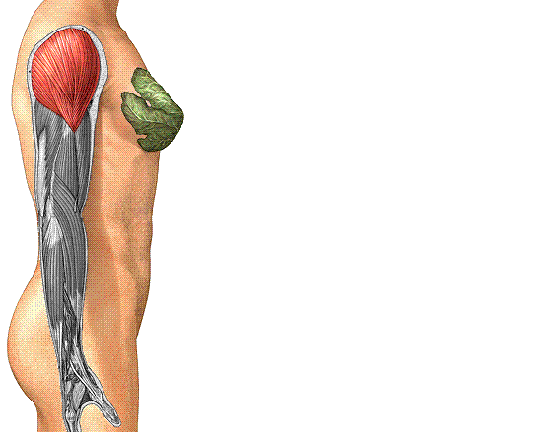
O: clavicle, scapula
I: humerus
F: abduct arm
Deltoid

Slide 3
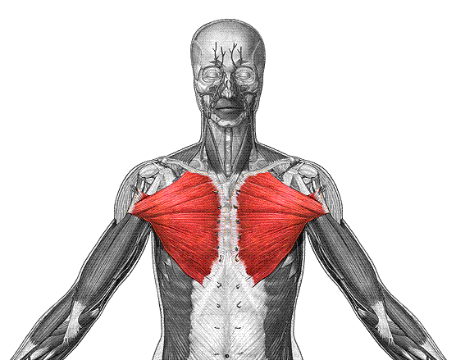
O: clavicle, sternum
I: humerus
F: flex, adduct arm
Pectoralis Major

Slide 4
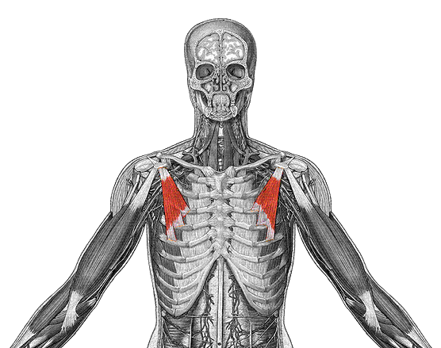
O: ribs
I: coracoid of scapula
F: depress scapula
Pectoralis Minor

Slide 5
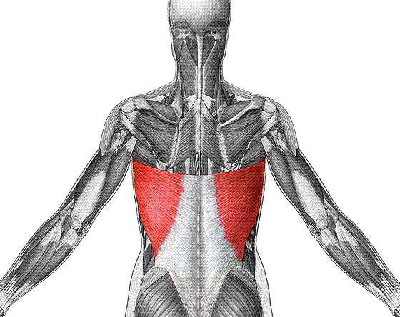
O: vertebrae
I: humerus
F: extend, adduct arm
Latissimus Dorsi

Slide 6
Muscles of the Rotator Cuff

Slide 7
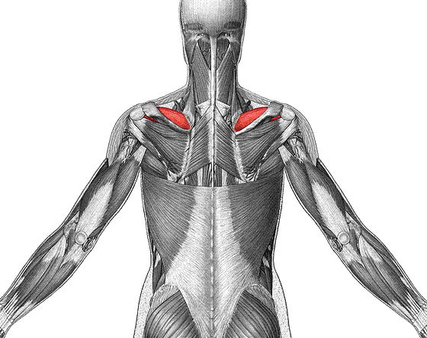
O: scapula
I: humerus
F: abducts arm, stabilize shoulder
Supraspinatus

Slide 8
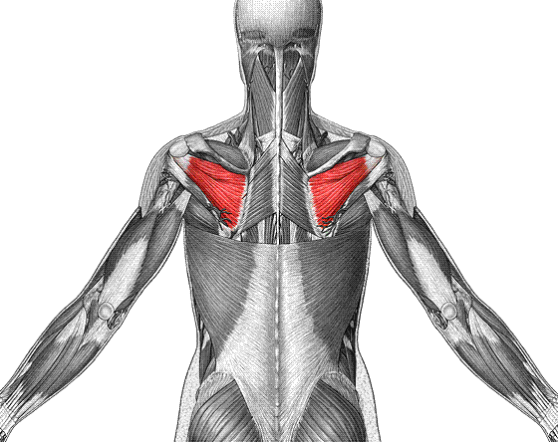
O: scapula
I: humerus
F: laterally rotate arm
Infraspinatus

Slide 9
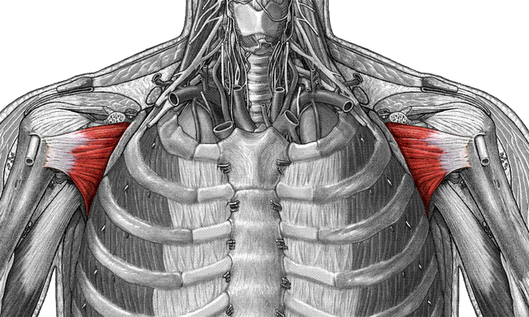
Subscapularis
O: scapula
I: humerus
F: medially rotate arm

Slide 10
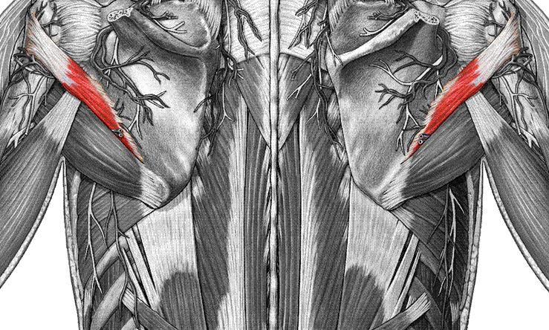
Teres minor
O: Lateral border of scapula
I: humerus
F: laterally rotate, adduct arm

Slide 11
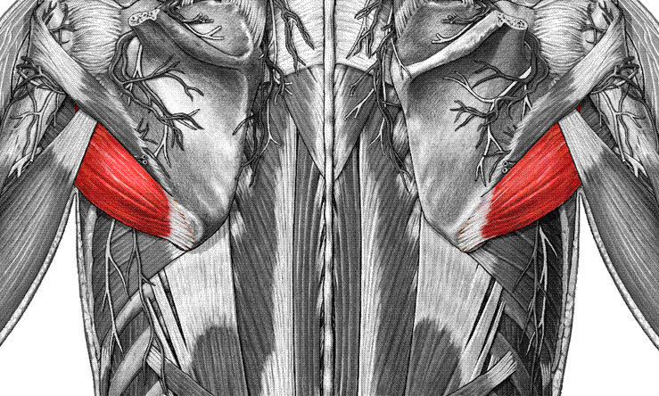
Teres major
O: inferior angle of scapula
I: humerus
F: extend, adduct arm

Slide 12
Muscles of the Upper Arm

Slide 13
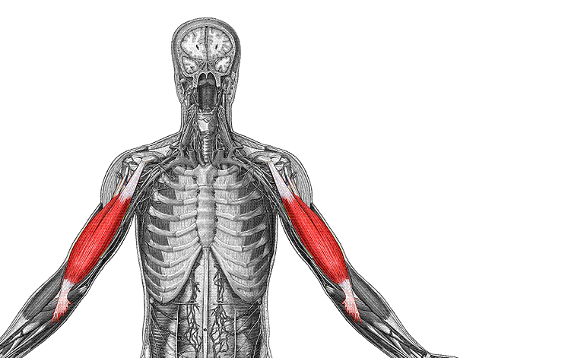
O: scapula
I: radial tuberosity
F: flex forearm & arm
Biceps brachii

Slide 14
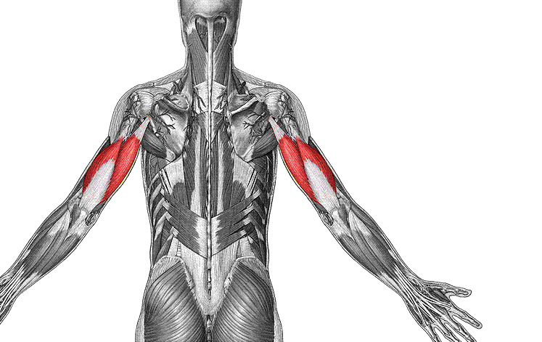
O: scapula & humerus
I: olecranon of ulna
F: extend forearm & arm
Triceps brachii

Slide 15
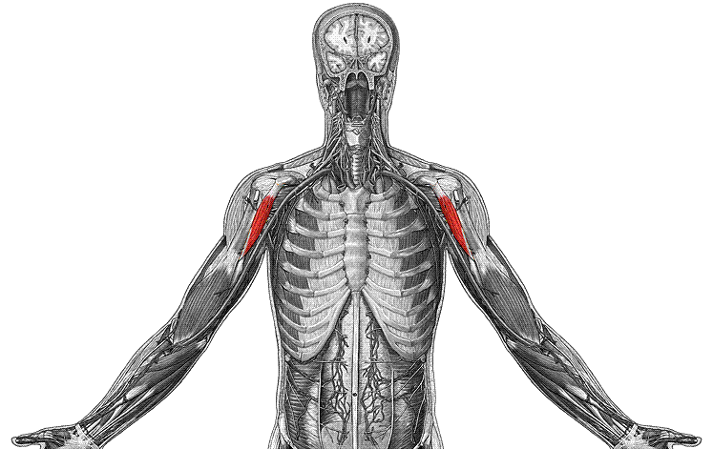
O: coracoid of scapula
I: humerus
F: flex and adduct arm
Coracobrachialis

Slide 16
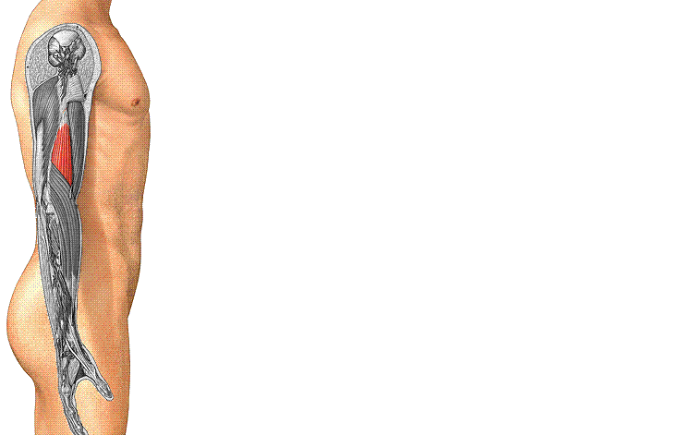
O: humerus
I: coronoid process of ulna
F: flex forearm
Brachialis

Slide 17
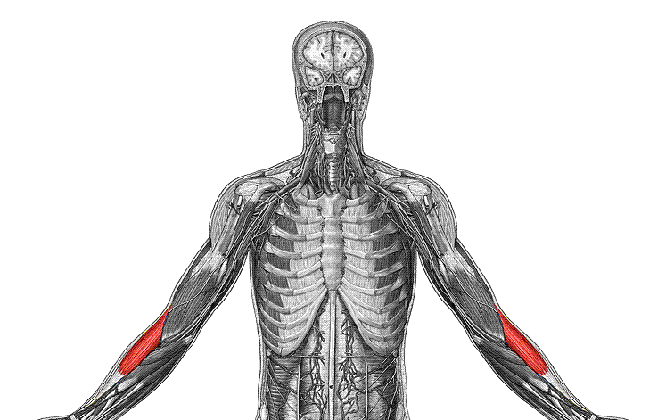
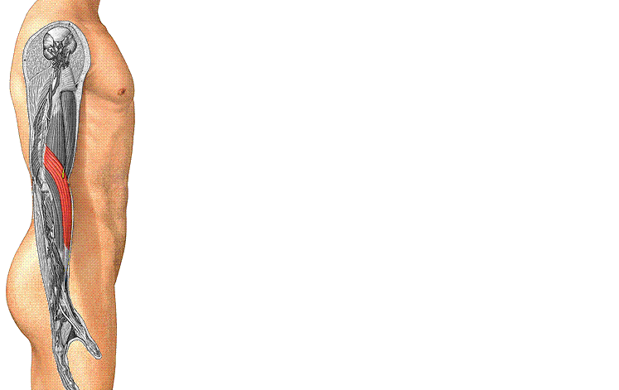
Brachioradialis
O: humerus
I: styloid of radius
F: flex forearm

